Slide 1
Welcome
to
Open Night
2023
Notes:
Welcome before we officially get started I will let you know the toilets are located out the side of this building to the left.

Slide 2
Acknowledgement of Country
Today at Keilor Downs College we meet on the traditional country of the Wurundjeri people of the Kulin Nation.
We pay our respect to Elders past, present and emerging, for they hold the memories, the traditions, the culture and the hopes of Aboriginal Australia.
We acknowledge their strong and living culture, and their unique role in the life of the region.
We remember that under the brick and asphalt this land was, and always will be, traditional Aboriginal land.
Notes:
We would like to acknowledge that all Keilor Downs College stands on the traditional lands of the Wurundjeri People of the Kulin Nation and pay respect to their elders, both past and present. We recognize their long custodianship of this land and appreciate their unique and on-going culture and role in the life of our communities.

Slide 3
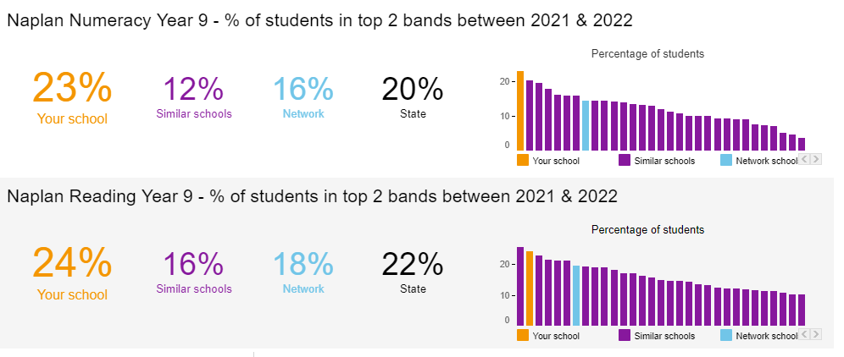
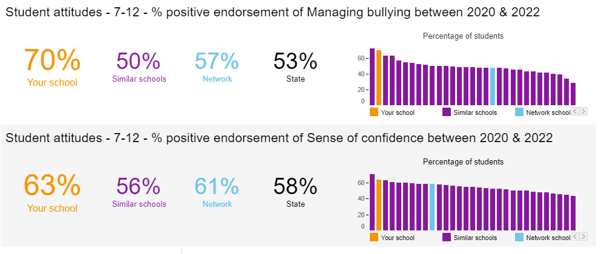
Comparative performance
Notes:
This graphic gives you a snapshot of relative growth of our students between Yr.7 and Yr. 9.
As you can see in each of the areas, reading, writing and numeracy our relative growth – the % of students who achieved high gain, is above similar schools (purple), a similar network school (blue) and the state figure (black).

Slide 4
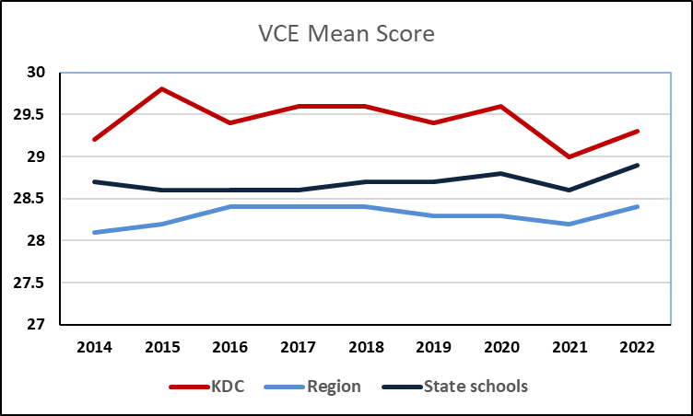
Year 12 Outcomes 2022
95% of students who applied got a tertiary offer
85% got one of their top 3 choices
22 students got Apprenticeships
Notes:
Our VCE all studies mean graph shows KDC’s improvement over the past 7 years. Last year we finally reached our goal of achieving the “magical” 30 which had been 7 or so years in the making. Our next challenge is to try and maintain this mean and reach this mark consistently.

Slide 5
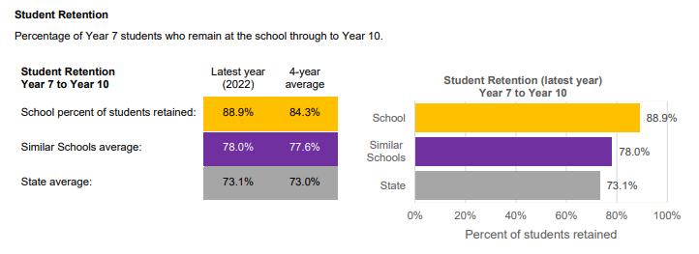

Slide 6
Student Wellbeing
Home groups
Houses
Wellbeing support
Social curriculum
Positive behaviour school
Notes:
One of the things that sets us apart from other schools is our well resourced and structured Student Wellbeing. There is a multifaceted approach that begins with students being placed in HGs. Students are placed in HGs based on constraints such as friendships, academic levels, special needs, language, gender etc. Each House (Yellow, Green, red, Blue) will have 2 or 3 HGs at each level. Each HG will stay together for the majority of classes in Year 7, 8 and 9 before students start to follow different pathways. Each HG meets for about 10 minutes every morning with their HG teacher who usually follows them through each year level (where possible).
Resourced Wellbeing – SWCs psychs youth worker GP

Slide 7
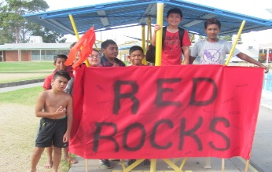
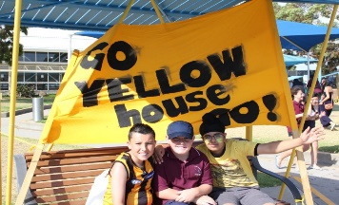
HOUSES
Future Young adults | 12B1 & 12B2 | 12G1 & 12G2 | 12R1 & 12R2 | 12Y1 & 12Y2
Study & work skills | 11B1 & 11B2 | 11G1 & 11G2 | 11R1 & 11R2 | 11Y1 & 11Y2
Pathways Counselling | 10B1 & 10B2 | 10G1 & 10G2 | 10R1 & 10R2 | 10Y1 & 10Y2
Choices Community | 9B1 & 9B2 | 9G1 & 9G2 | 9R1 & 9R2 | 9Y1 & 9Y2
Social skills Resilience | 8B1 & 8B2 | 8G1 & 8G2 | 8R1 & 8R2 | 8Y1 & 8Y2
Transition Group building | 7B1 & 7B2 | 7G1 & 7G2 | 7R1 & 7R2 | 7Y1 & 7Y2
Notes:
With 2 or 3 HG per year level each House contains approx. 15 HGs across Year 7 – 12. This allows the members of each house team (House leader, coordinators and STA) to build relationships with the student and family over the course of their time at KDC. The Houses have been one of the contributing factors to our positive learning environment.
Student misbehaviour is very low allowing House staff to work with students that require extra support in areas such as mental health, attendance, friendships etc.

Slide 8
Curriculum
Well planned & sequential
Differentiated for mixed abilities
Building skills & knowledge
Promoting independence
High expectations
Notes:
As you should of seen through visiting the KLA displays this evening, our curriculum is delivered by passionate and knowledgeable staff who are “specialists” in the learning area. Our curriculum team is constantly working to differentiate curriculum and improve the teaching and learning within the college. Most recently this work has been on the thinking skills which aims to provide students with the tools to approach new information and apply their knowledge independently in a variety of situations.

Slide 9
What does the Year 7 curriculum look like?
English | Maths | Humanities | Science | LOTE Italian Japanese
5 | 5 | 3 | 3 | 3
PE | Technology Food Digital | Arts Music 2D Art | Explore Me | Home Group
2 | 3 | 3 | 3 | 10 mins
Notes:
So what does the Year 7 curriculum look like?
Year 7 students will complete core subjects such as English, Maths …. With electives in Technology and Arts as well as an “Explore” class which has a pastoral care focus.

Slide 10
SEAL Program
SEALP is the Select Entry Accelerated
Learning Program
An entrance exam will be held in August after enrolments are determined
SEAL students are a separate home group who work at an accelerated pace in most of their subjects
This is a special support program for highly gifted students
Selection is determined by performance in the exam and interviews
Notes:
For those interested in testing for our SEAL program testing occurs this Saturday 4th May. If you haven’t already expressed your interest you do so through the General Office. Cost for ACER testing is $75. High performing students on the test will be asked to attend an interview as part of the selection process.

Slide 11
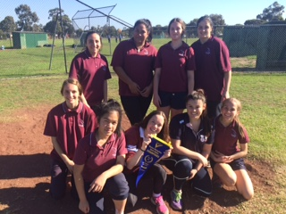
Opportunities
Student leadership
Music – stage band, groups, choir, musical
Sport – Volleyball, Cricket, Softball, Football etc.
Soccer School
Academic competitions – Mathematics, Science
Debating, Chess, Drama, Lego Club, Photography Club, Coding Club …….
Notes:
Of course there are a large number of extra curricular activities for students to participate in including…

Slide 12
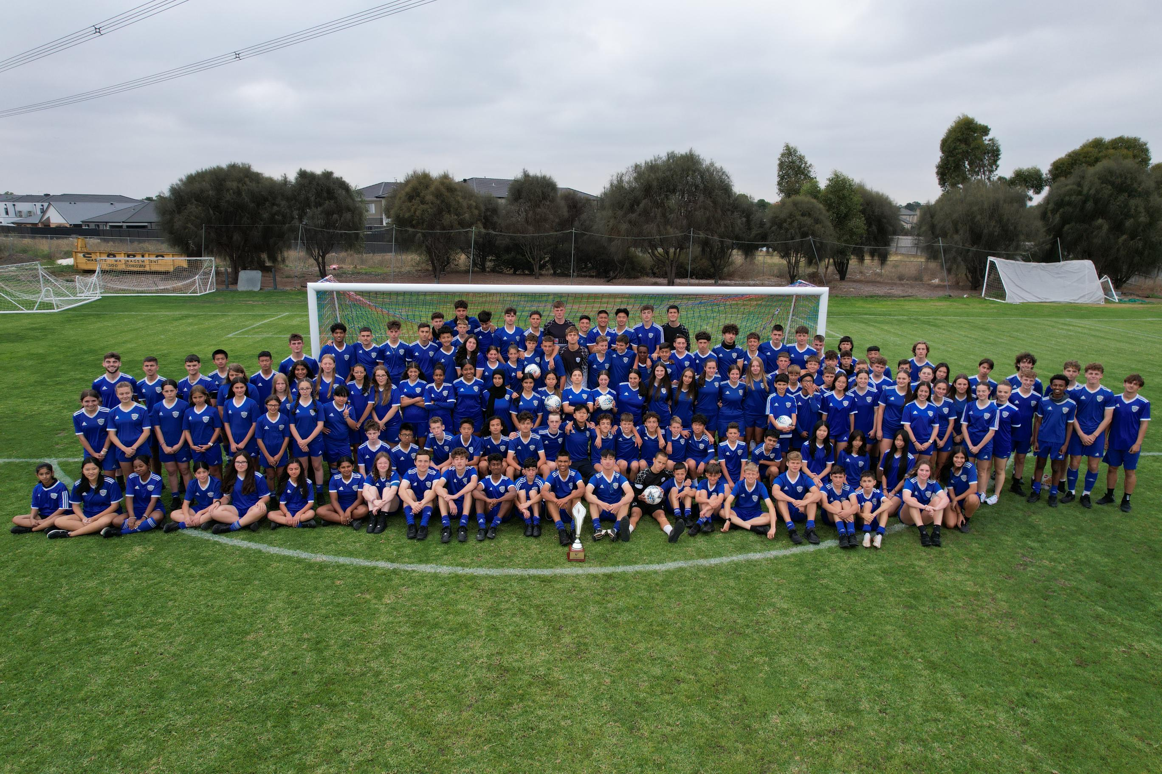
Soccer School
There are 25 places available in the program.
You must be enrolled at KDC first, then selected for the program.
Enrolment is via application, a skills assessment, and an interview.
Working with highly qualified and enthusiastic coaches
Annual fee of approx. $350 (includes uniform)
Notes:
Soccer School enrolment is dependent on placement at KDC. Our soccer group will be selected through trial and interview from those who are successfully enrolled.

Slide 13
Current Year 7 Students
Ramani Steinke
Inara De Rosayro
Jasmeet Kaur
Notes:
Next can I ask Binusha, Rowan and Abilash to come up the front. As well as Sabrina one of our peer support leaders.

Slide 14
Transition
Parent/student interviews (November)
Home group teachers
Home group room
Explore Program
Year 7 Camp
Peer Support Program
Year 7 Go – 2-day induction program
Notes:
Once accepted here at KDC the first real contact you will have with the school will be the parent/student interviews held in October. This is an opportunity for your child to let us know what they like (and don’t like), what they are good at and any requests for placement with others. The HG teacher has already been discussed, the HG room will be the class they have the most classes in to reduce movement (8Ha) – Eng, Maths, Hums and explore (which will be discussed shortly). Peer support program….. Camp. Also in Term 1 students have an Activity Day to run through the KDC 3 and student expectations before a Year 7 BBQ gives parents an opportunity to meet the HG teacher and House staff and mix and meet other parents from your child’s HG.

Slide 15
Peer Support
Isabella Koek
Lena Blaszkowska

Slide 16
What distinguishes KDC?
Excellent academic achievements
Strong, positive relationships
Individualized knowledge of students
Caters well for all abilities
Outstanding attendance & retention
Safe and supportive learning environment
Notes:
In summary what can KDC offer your child?....

Slide 17
Year 12 Students
Rocco Di Tirro
Naadira Rajudin
Ongegu Ndubi

Slide 18
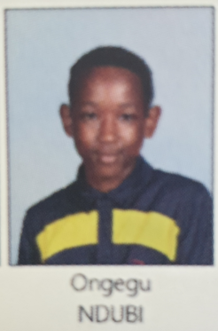
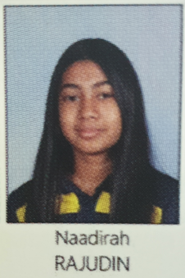
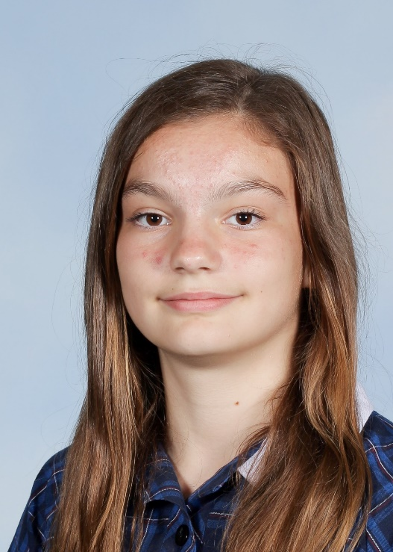
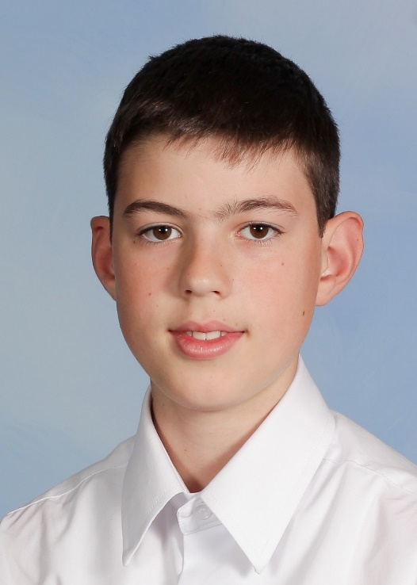
When they started…

Slide 19
Where to from here?
Enrolment preference forms | Friday 12th May.
Government primary schools | Return forms to primary school.
Catholic & Independent schools | Return directly to KDC office
Families notified of placement | Wednesday 19th July
Appeals to secondary schools | Close on 28th July
KDC sends out confirmation letter and enrolment packages | Late August
KDC Parent/Student Interviews | Late October/Early November
Orientation Day | Tuesday 12th December

Slide 20
www.findmyschool.vic.gov.au

